Slide 1







The Other Cloud for .NET Developing with .NET 7 on AWS Chris Woodruff

Slide 2


Chris Woodruff
cwoodruff@live.com
+1 616 724 6885
@cwoodruff

Slide 3

What do you need to start using AWS?

Slide 4
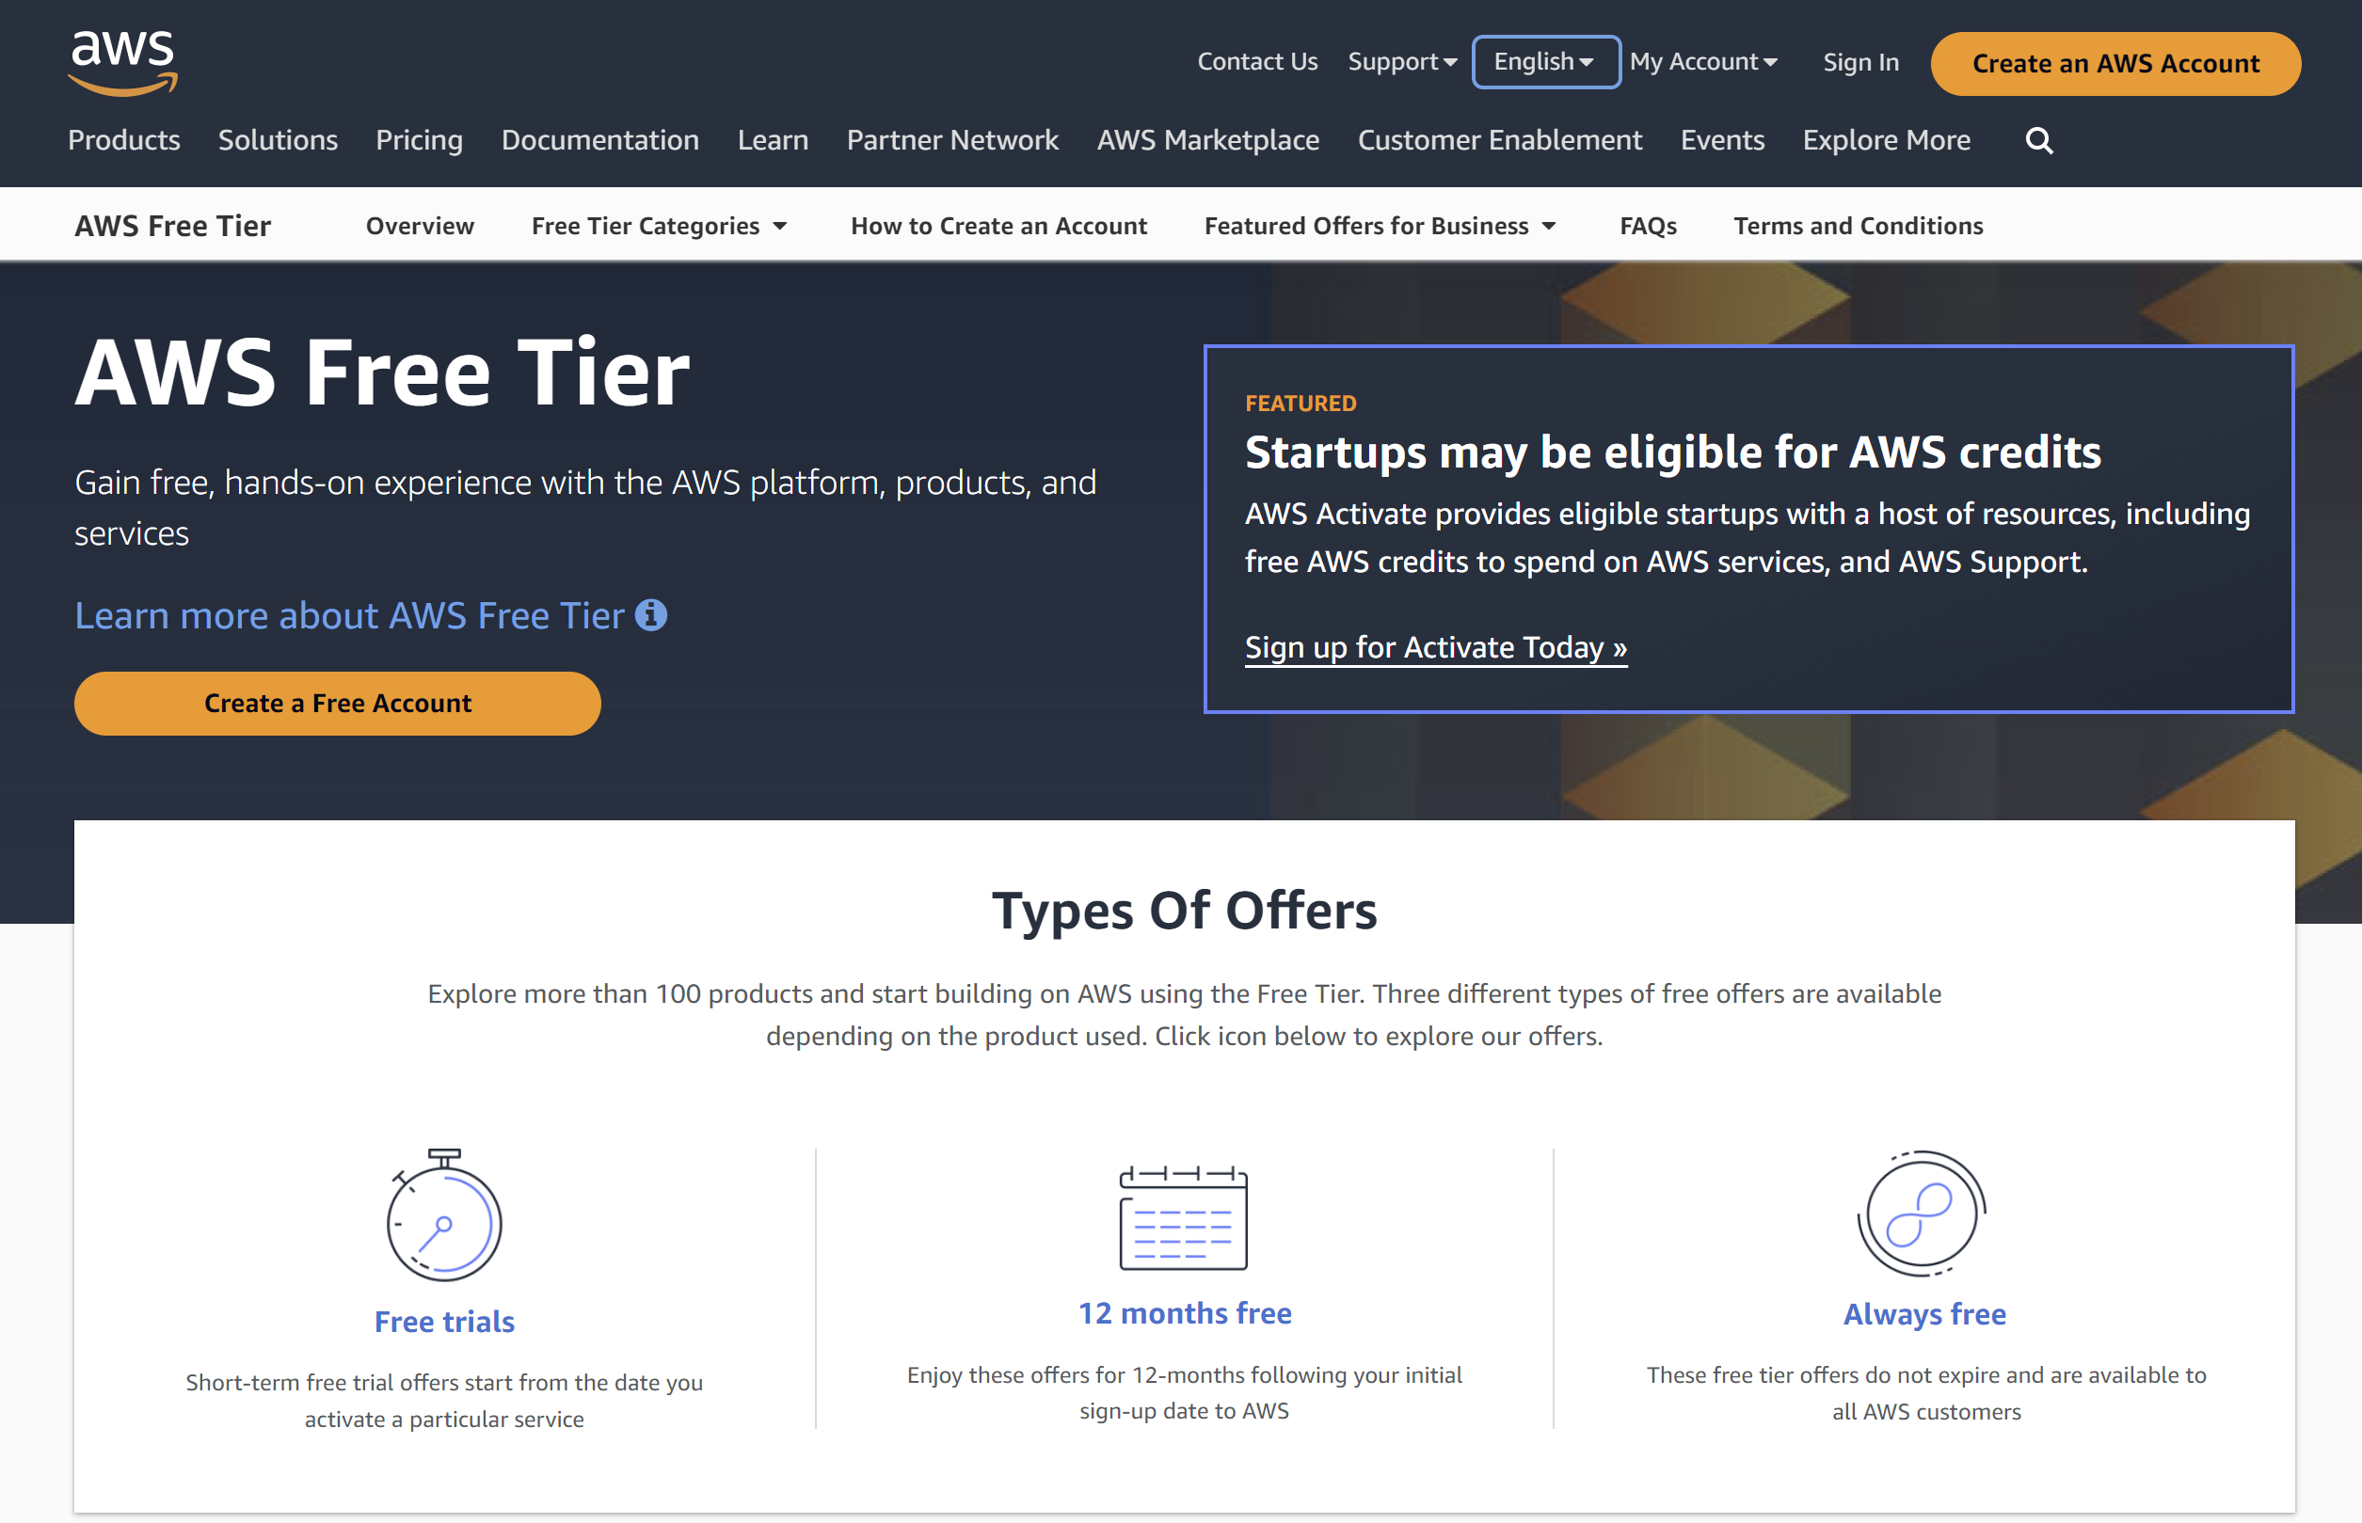
Sign up for an AWS Account

Slide 5
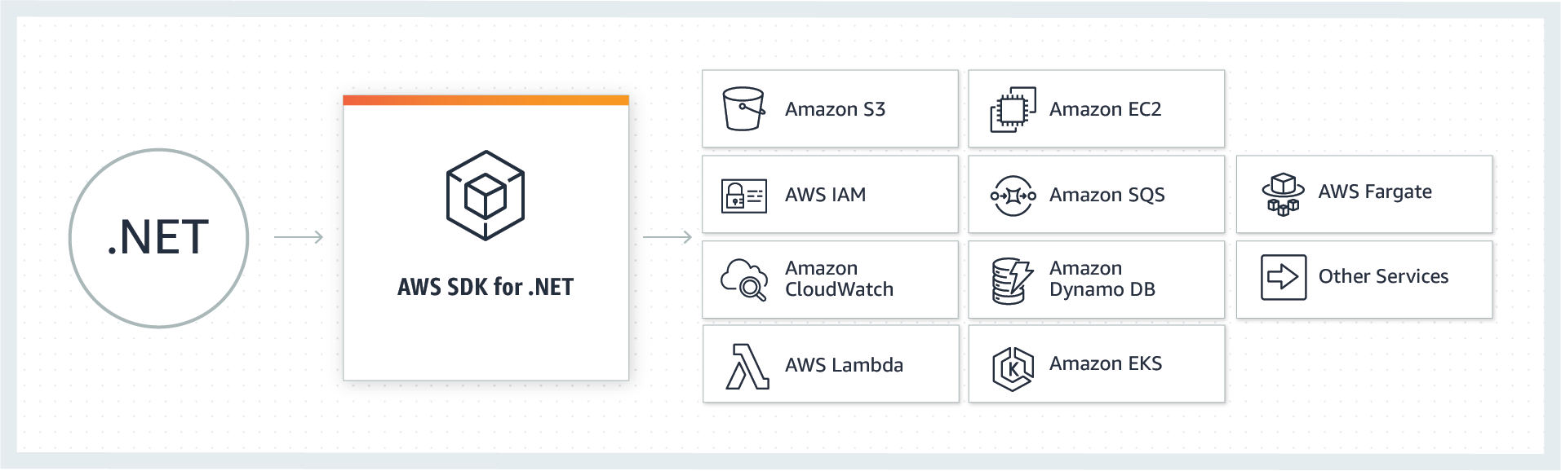
AWS SDK for .NET

Slide 6
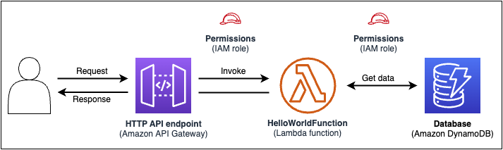
AWS Serverless Application Model (AWS SAM)
AWS SAM template specification
AWS SAM command line interface

Slide 7
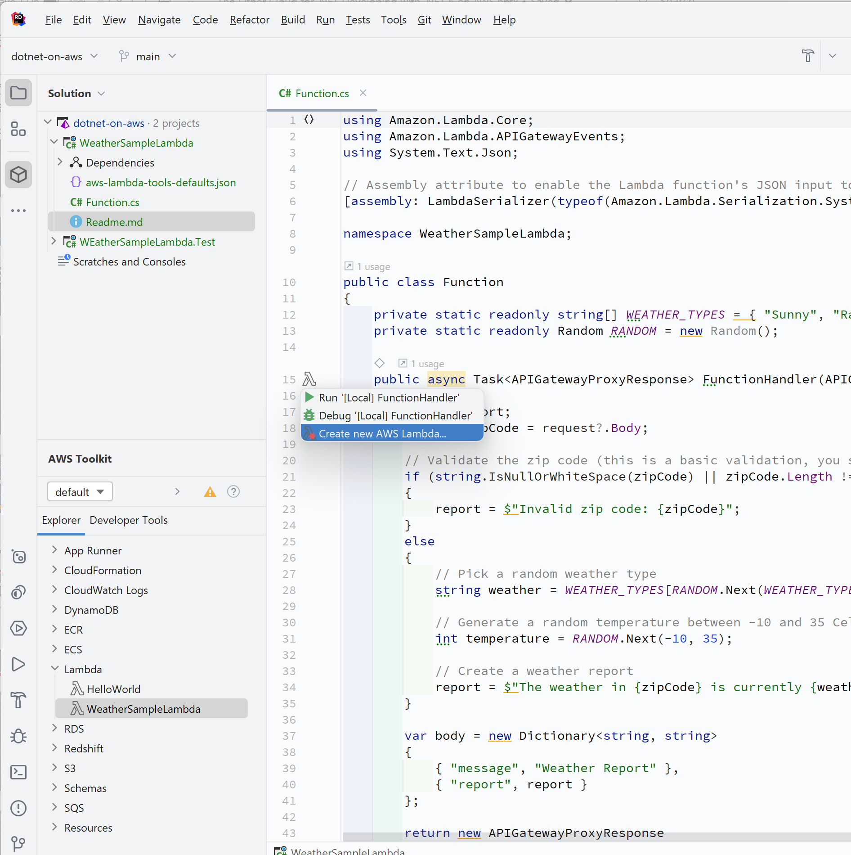
AWS Toolkit for your IDE
Visual Studio
JetBrains Rider
Visual Studio Code

Slide 8
AWS CodeCatalyst

Slide 9
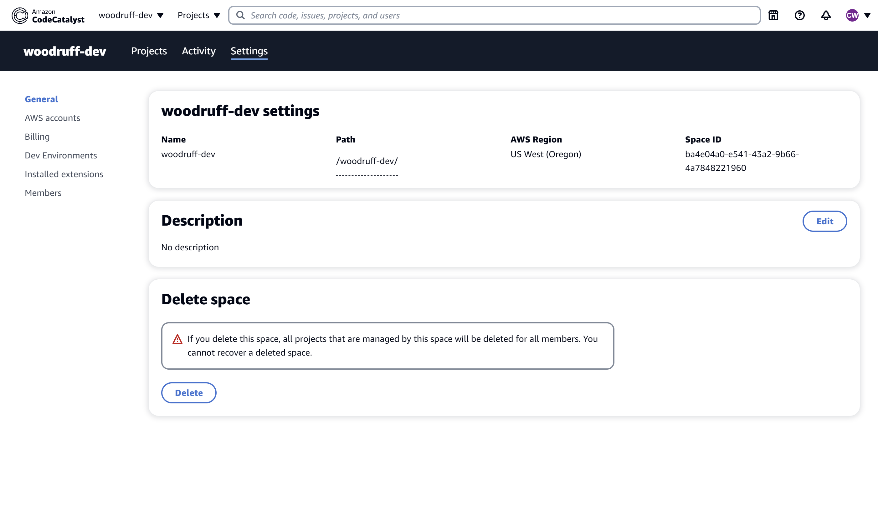
CodeCatalyst Space

Slide 10
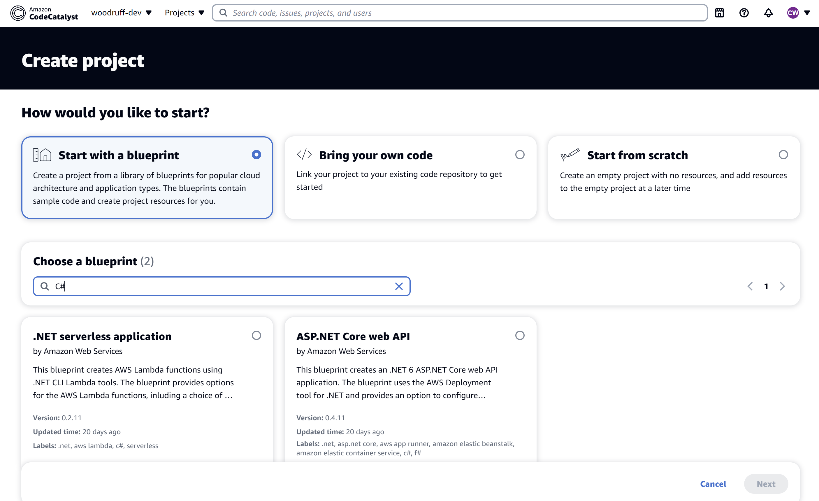
CodeCatalyst Project

Slide 11
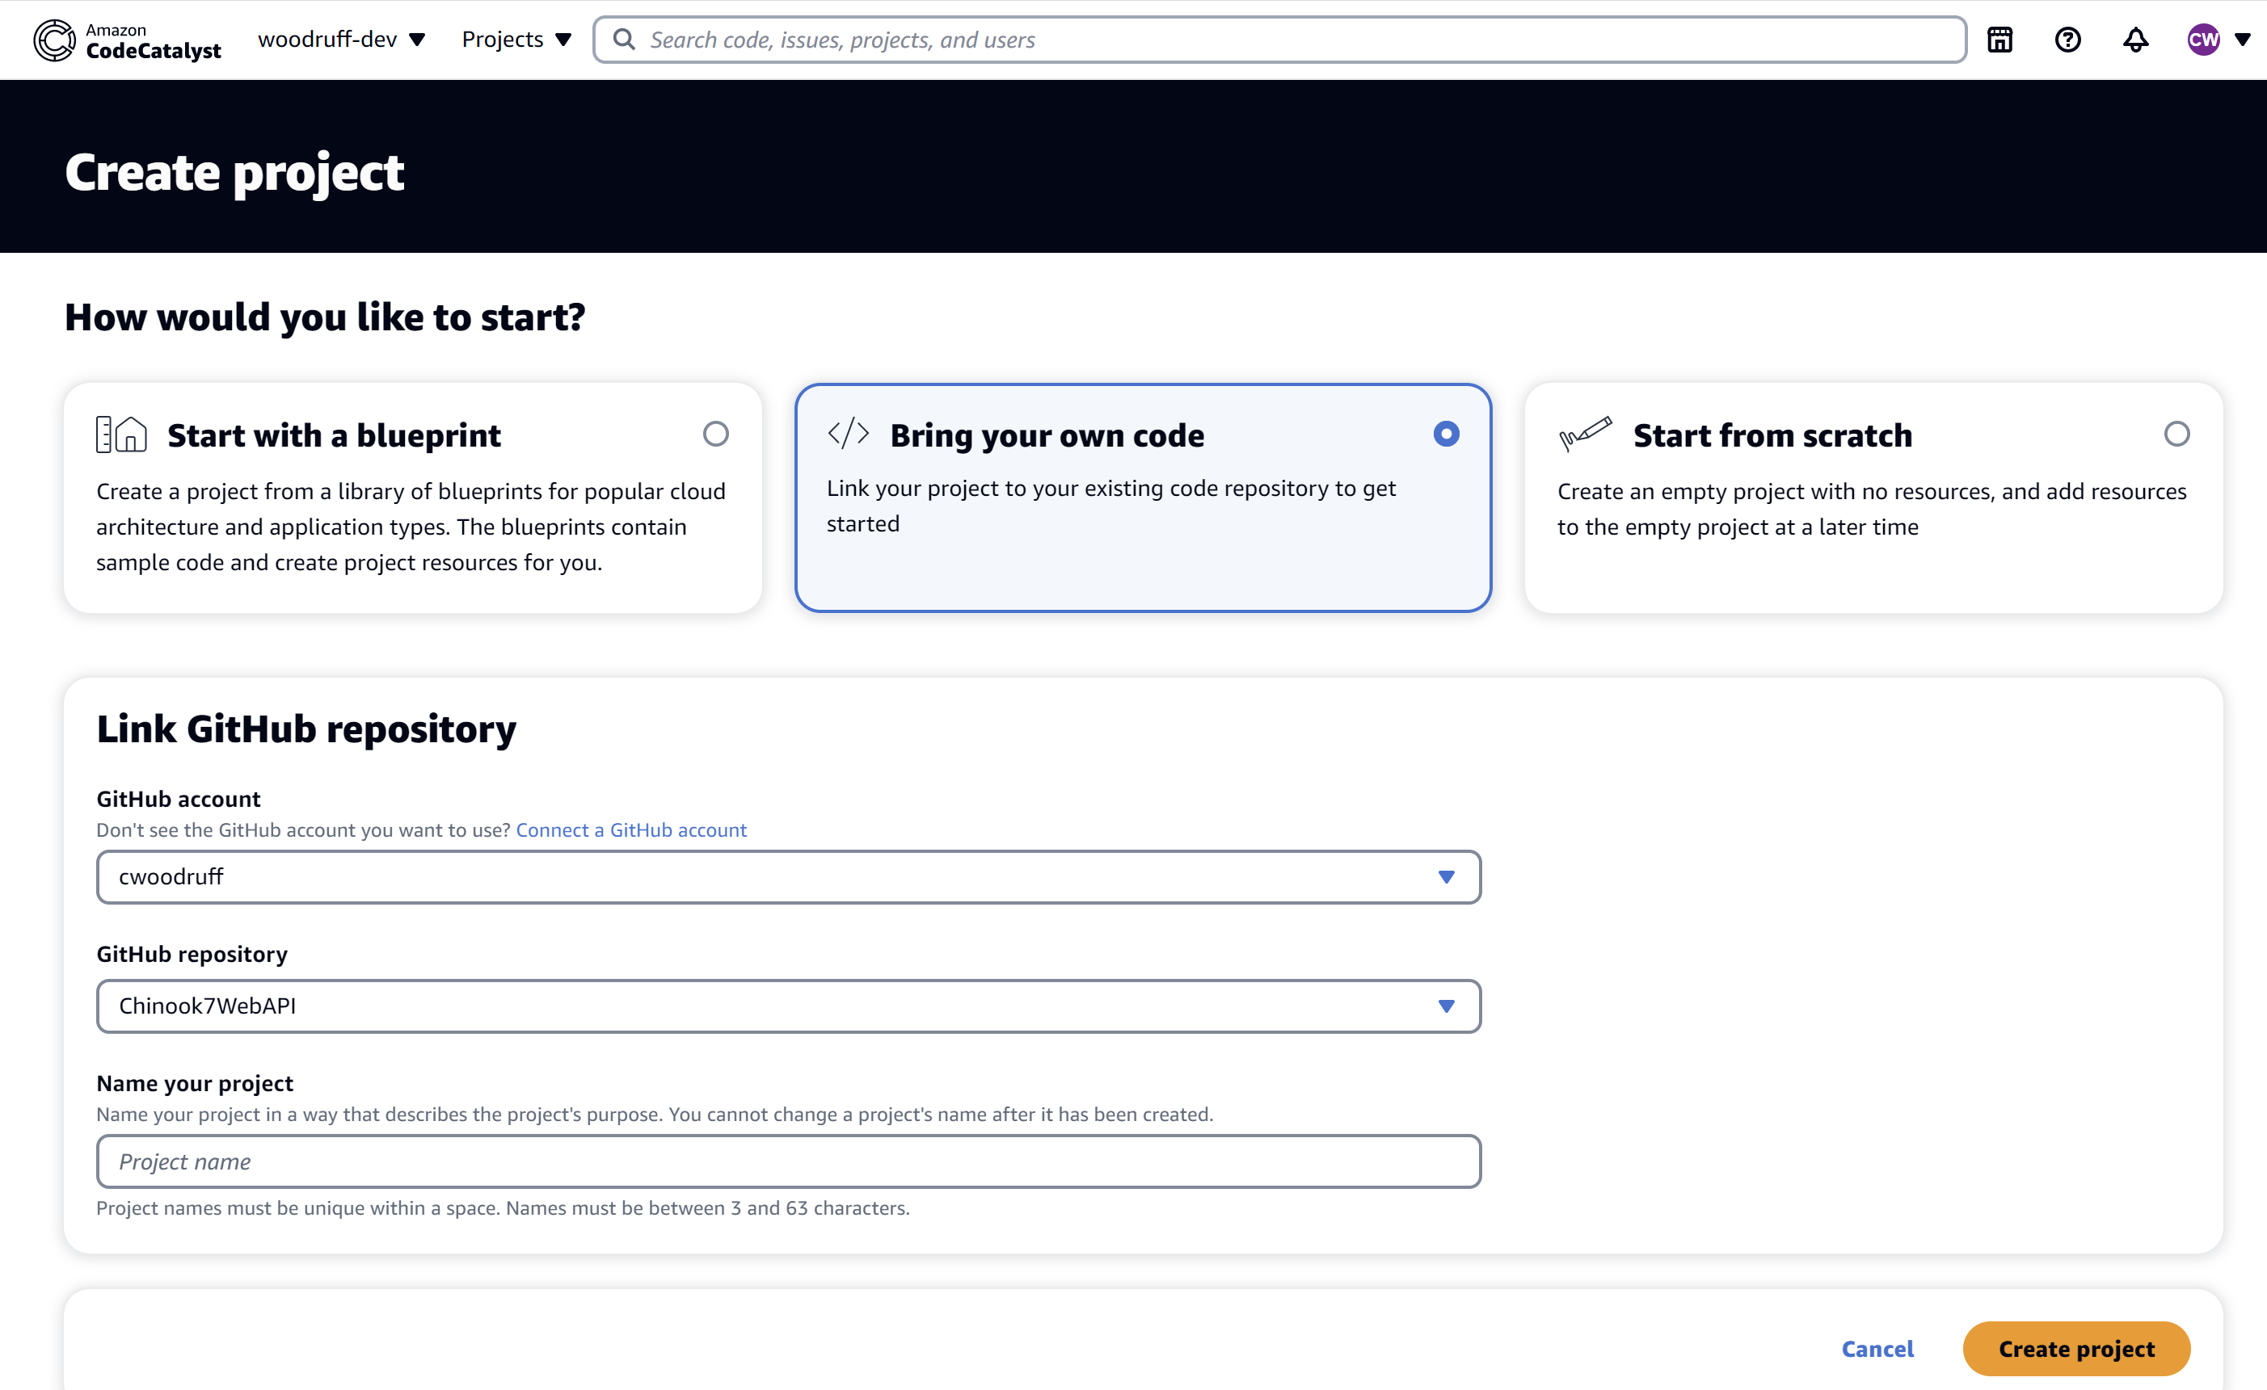
CodeCatalyst Project

Slide 12
Amazon RDS

Slide 13
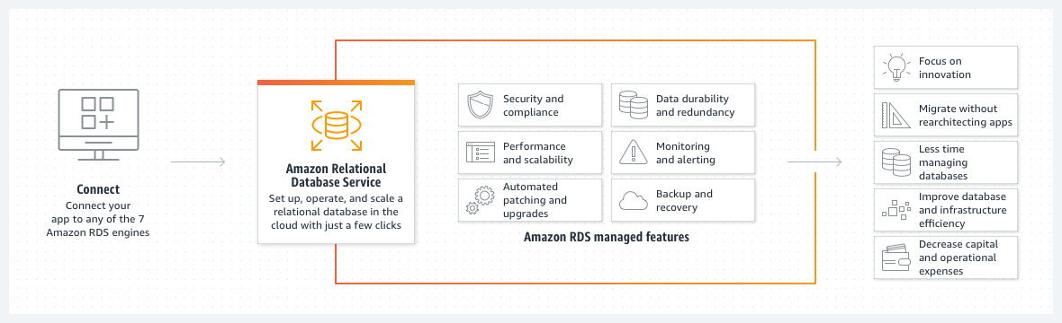
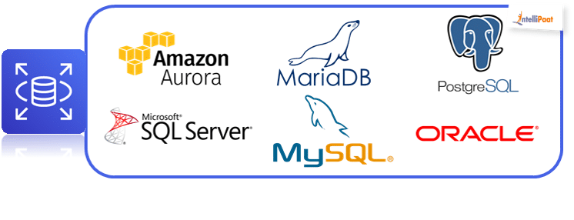
Amazon RDS

Slide 14
Amazon DynamoDB

Slide 15
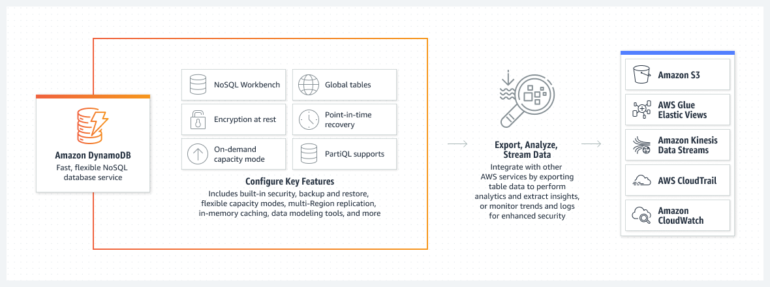
Amazon DynamoDB

Slide 16

AWS CloudWhisperer

Slide 17
AWS Lambda

Slide 18


Slide 19
AWS Microservice Extractor for .NET

Slide 20
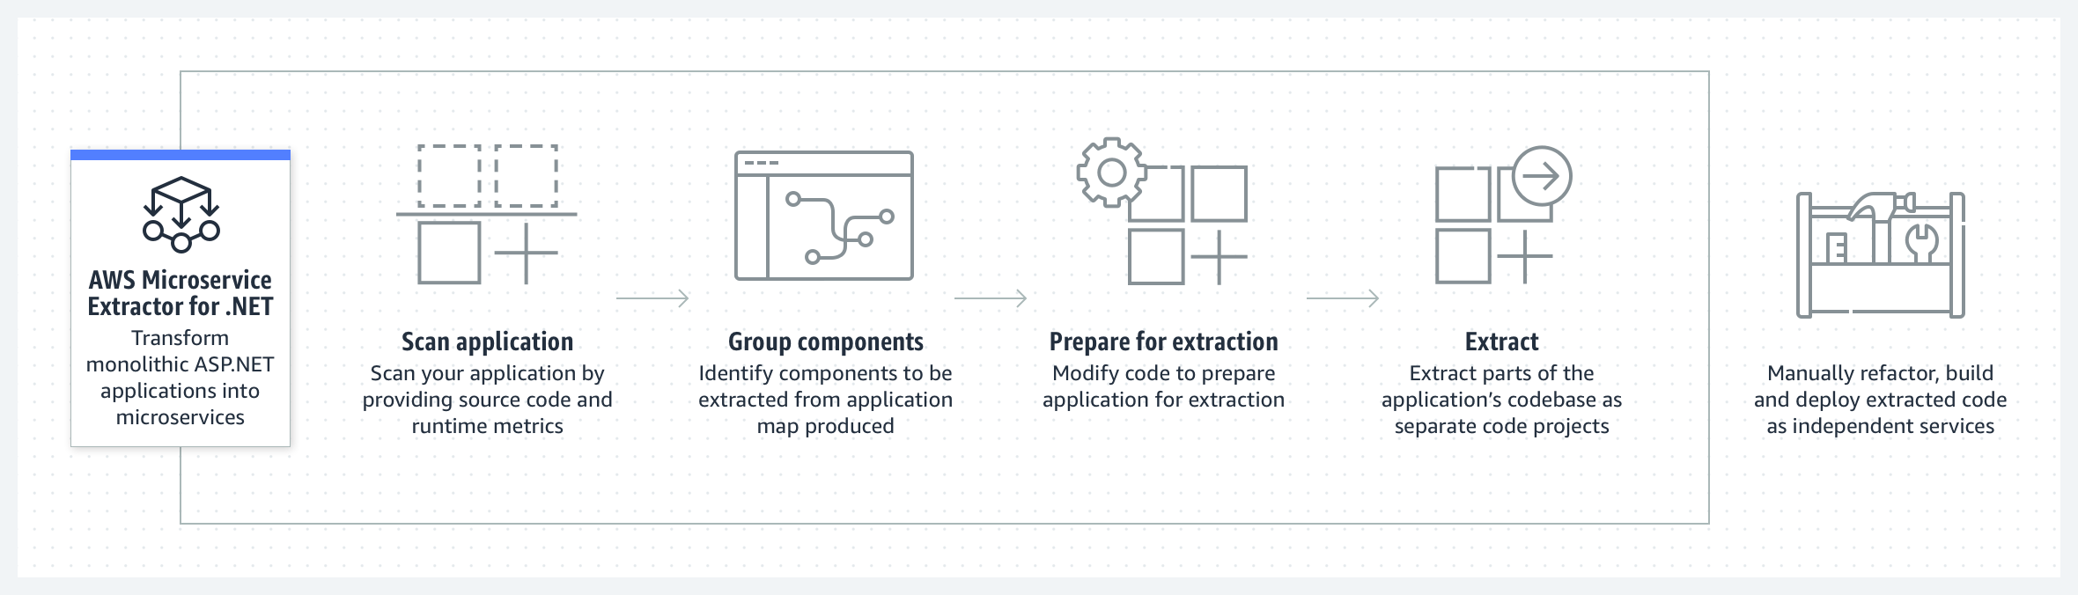
AWS Microservice Extractor for .NET

Slide 22
AWS Identity and Access Management

Slide 23
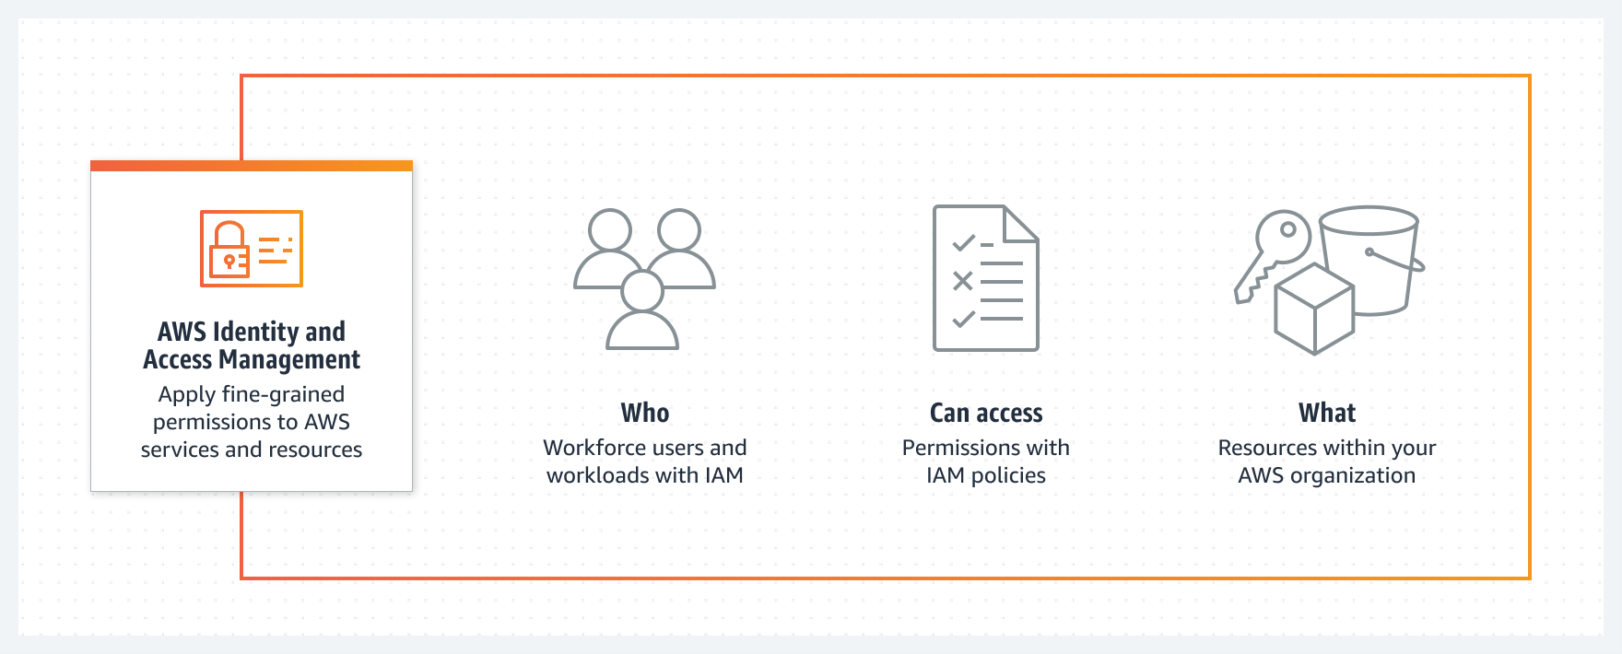
AWS Identity and Access Management

Slide 24
AWS Secrets Manager

Slide 25
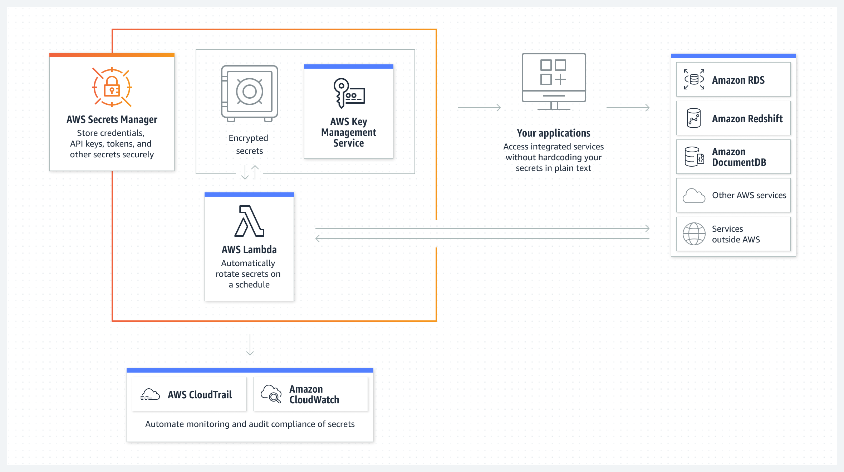
AWS Secrets Manager

Slide 26
AWS CloudWatch

Slide 27
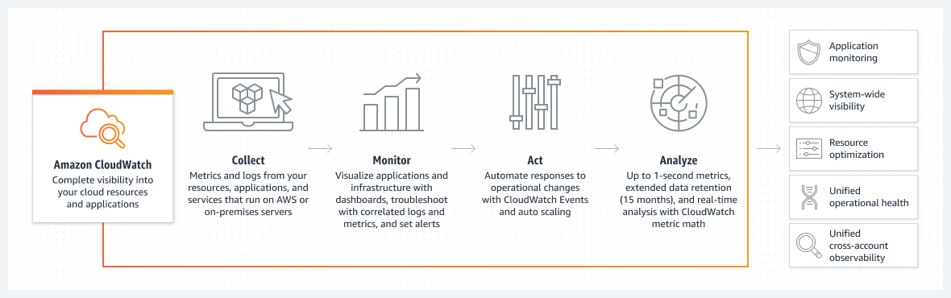
AWS CloudWatch

Slide 28
AWS Toolkit for .NET Refactoring
How you can log data from C# to CloudWatch Logs
var awsAccessKeyId = "your access key";
var awsSecretAccessKey = "your secret access key";
var logGroupName = "your log group name";
var logStreamName = "your log stream name";
var client = new AmazonCloudWatchLogsClient(awsAccessKeyId, awsSecretAccessKey, RegionEndpoint.USWest2);
var request = new PutLogEventsRequest
{
LogGroupName = logGroupName,
LogStreamName = logStreamName,
LogEvents = new List<InputLogEvent>
{
new InputLogEvent
{
Message = "This is a test message",
Timestamp = DateTime.UtcNow
}
}
};

Slide 29
AWS Toolkit for .NET Refactoring

Slide 30
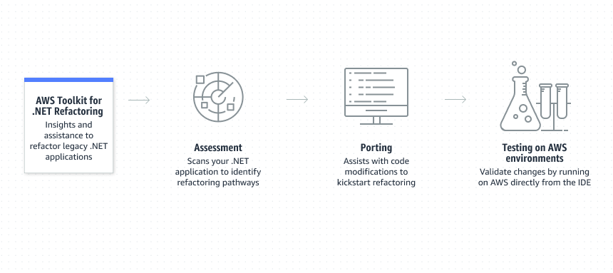
AWS Toolkit for .NET Refactoring

Slide 31
AWS Toolkit for .NET Refactoring

Slide 32

AWS CloudFormation

Slide 33
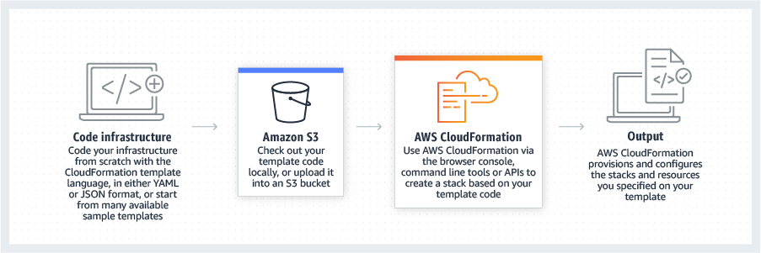
AWS CloudFormation

Slide 34
AWS BeanStalk

Slide 35
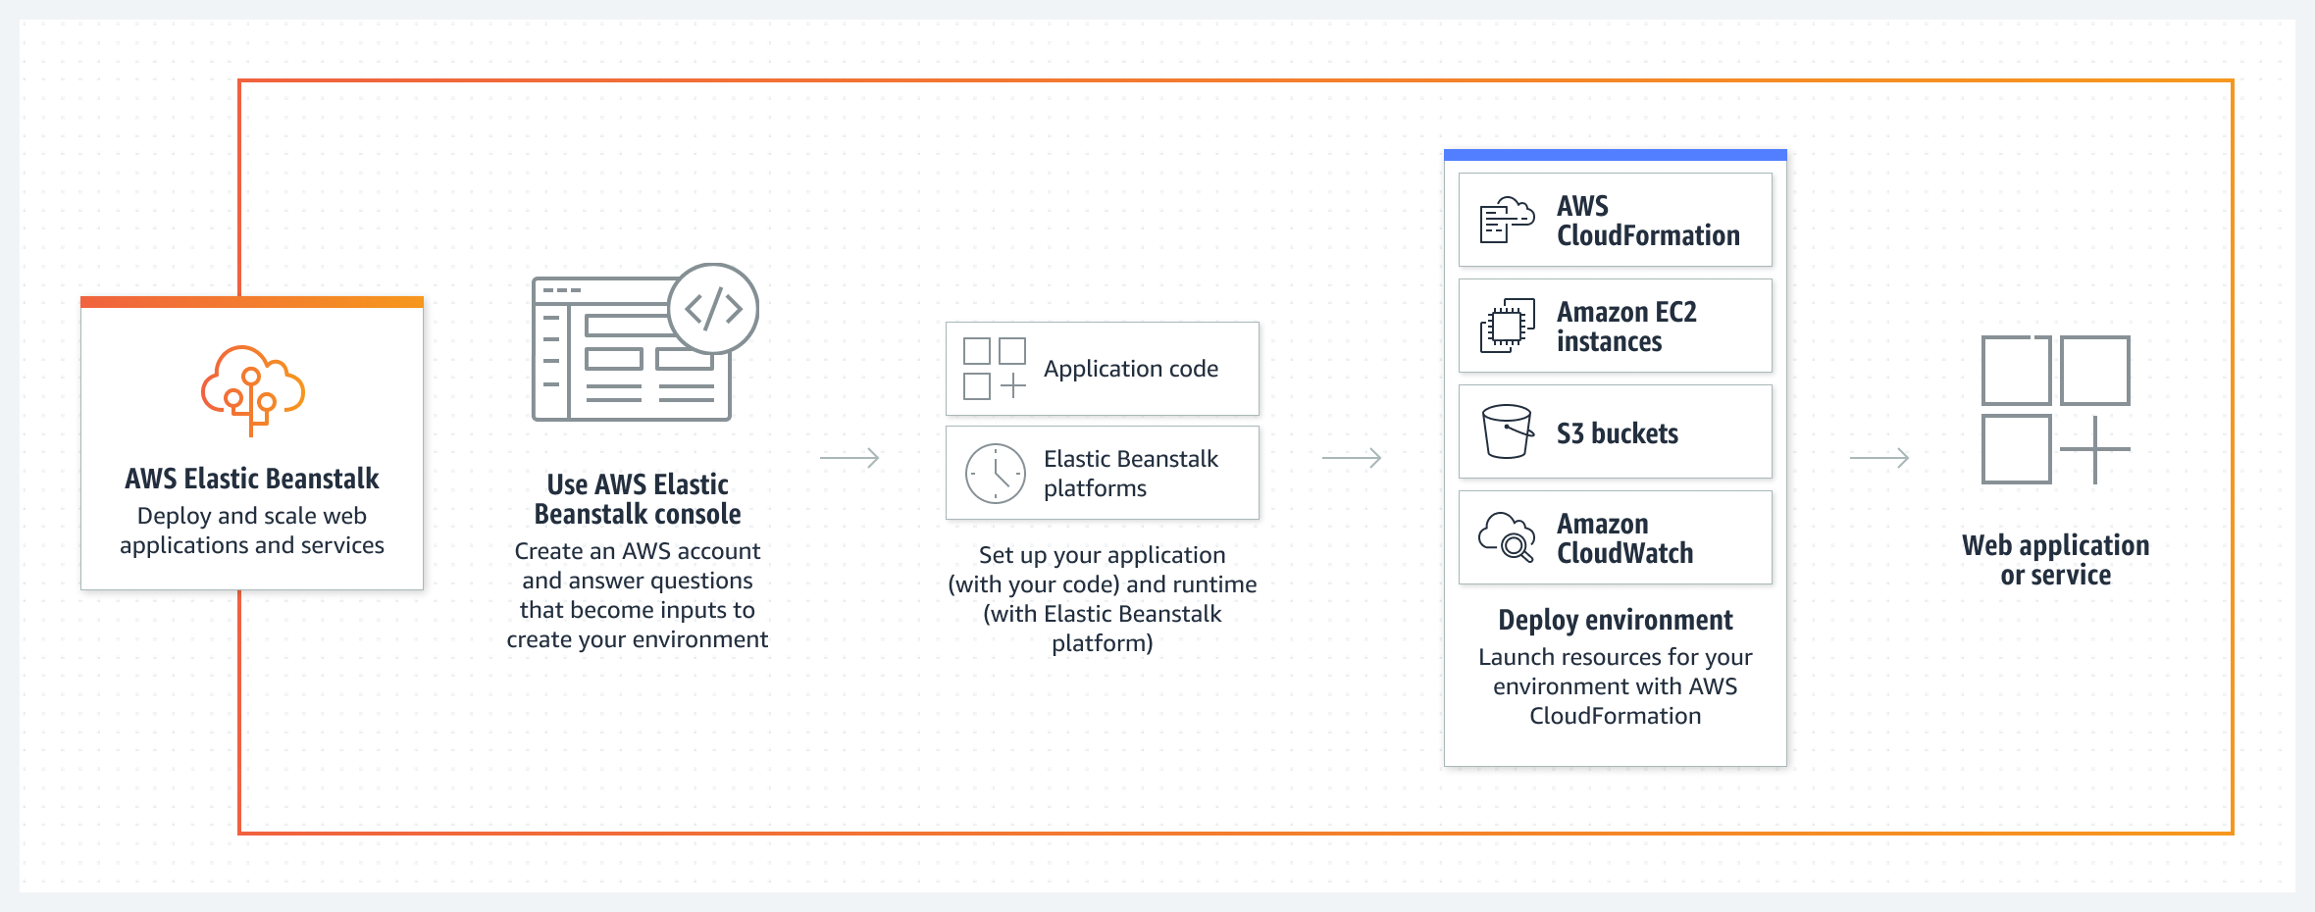
AWS BeanStalk

Slide 36
AWS Load Balancing

Slide 37
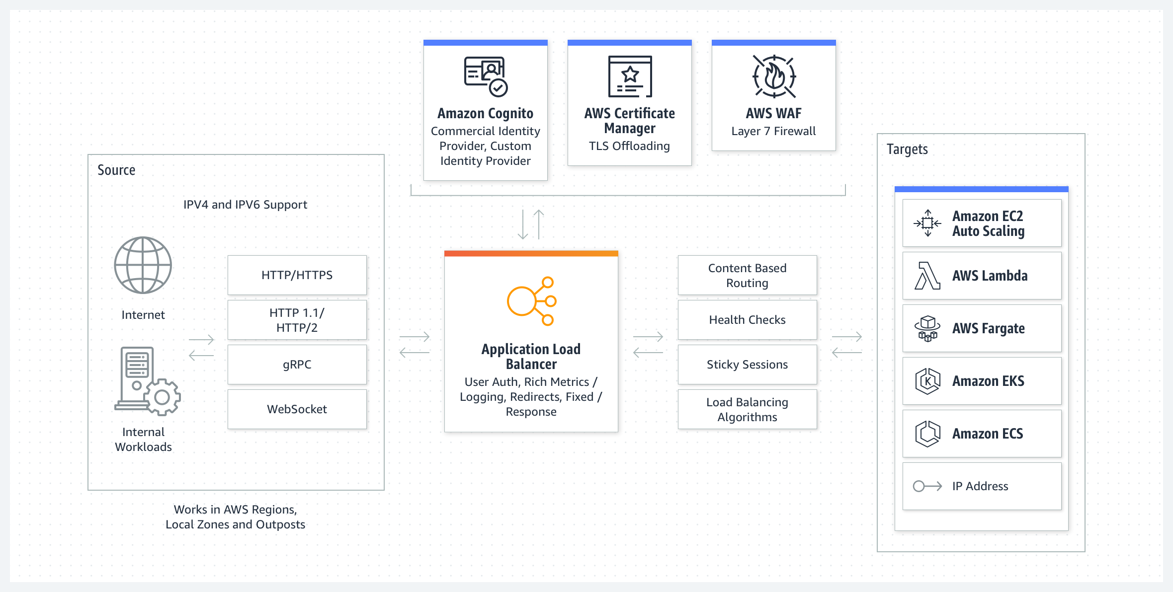
AWS Load Balancing

Slide 38
AWS App2Container

Slide 39
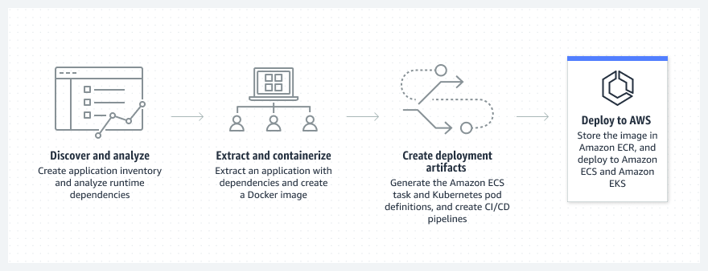
AWS App2Container

Slide 40
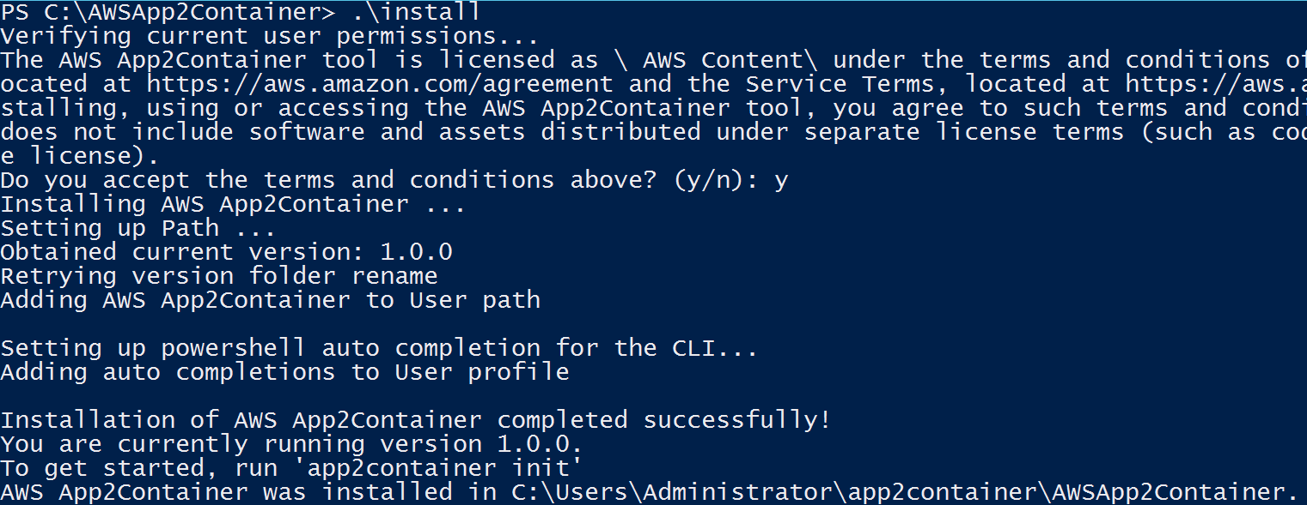

Slide 41
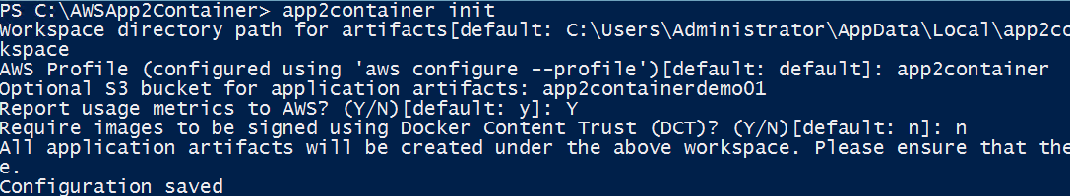

Slide 42
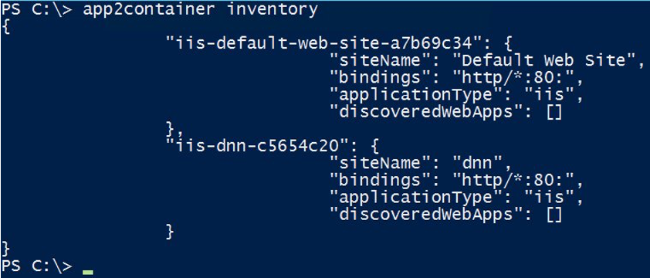
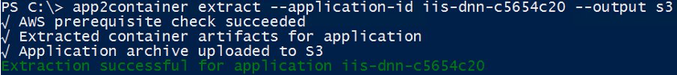

Slide 43
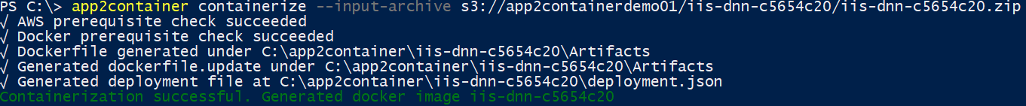
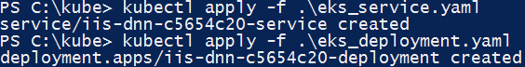

Slide 44
Q&A

Slide 45

Resources
https://aws.amazon.com/developer/language/net/
https://github.com/aws/dotnet
https://aws.amazon.com/sdk-for-net/
https://aws.amazon.com/sdk-for-net/
.NET Immersion Day
http://surl.li/hhrey

Slide 46
Thank you!!!

